Slide 1
Data Science Engineering Methods and Tools Lecture 3
Northeastern University
College of Engineering
INFO 6105 – Spring 2024
Abdolreza Mosaddegh

Slide 2
Clustering
Clustering is a technique for finding similar groups in data, called clusters, i.e.,
it groups data instances that are similar to (near) each other in one cluster and data instances that are not similar (far away) to each other into different clusters.
Clustering is often an unsupervised learning task as no class values (labels) indicate group of the data instances.
Clustering is the most common form of unsupervised learning.
clustering is one of the most utilized ML techniques and used in almost every field, e.g., medicine, psychology, sociology, biology, archeology, marketing, insurance, libraries, security, etc.

Slide 3
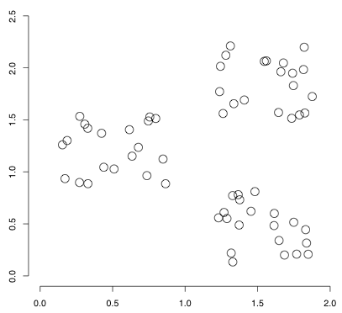
Dataset with clear cluster structures
Attribute A
There are 3 cluster structure in this example
Attribute B

Slide 4
Applications of Clustering
• Customer Segmentation
• Data Summarization and Analysis
• Finding representatives (Labels) for unlabeled data groups
• Finding unusual data points and outliers
• Community detection in Network Analysis
Gain insight into the structure of the data
Other application such as Image Processing, object detection, noise identification, etc.

Slide 5
Problem Statement
Given a set of data points, each described by a set of attributes (features), find clusters (groups) such that:
Inter-cluster (within a cluster) similarity is maximized
Intra-cluster (between clusters) similarity is minimized
Requires the definition of a metric for similarity
F1
x
x
x
x
x
x
x
x
xx
x
x
x
x
x
x
xx
x
F2
Notes:
Data

Slide 6
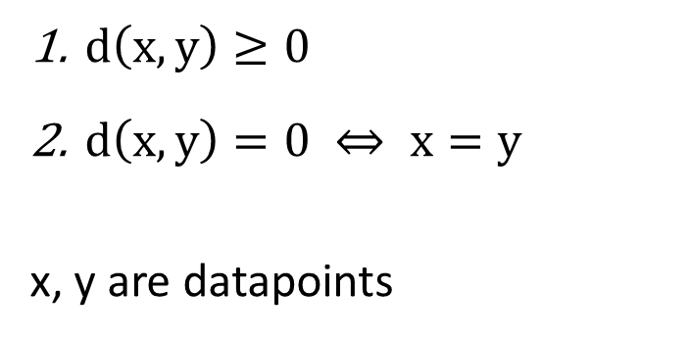
Similarity vs. Distance
Similarity indicates less distance between attributes (features) of two data points
A distance measure (metric) is a function that satisfies:
Distance is the Loss Function in clustering
Features used to recognize similarity of clusters
Clustering Type
$d\left(x,y\right)≥0$
$d\left(x,y\right)=0 ⇔ x=y$
x, y are datapoints

Slide 7
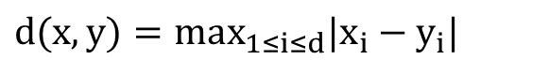
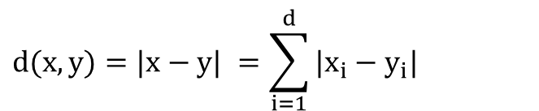

Distance Measures
Euclidean Distance:
Manhattan Distance:
Chebyshev Distance:
$$d(x,y)=\sqrt{(x−y)^{2}}=\sqrt{\sum_{i=1}^{d}{(x_{i}−y_{i})^{2}}}$$
$$d(x,y)=|x−y| =\sum_{i=1}^{d}{|x_{i}−y_{i}|}$$
$$d(x,y)=max_{1≤i≤d}|x_{i}−y_{i}|$$

Slide 8
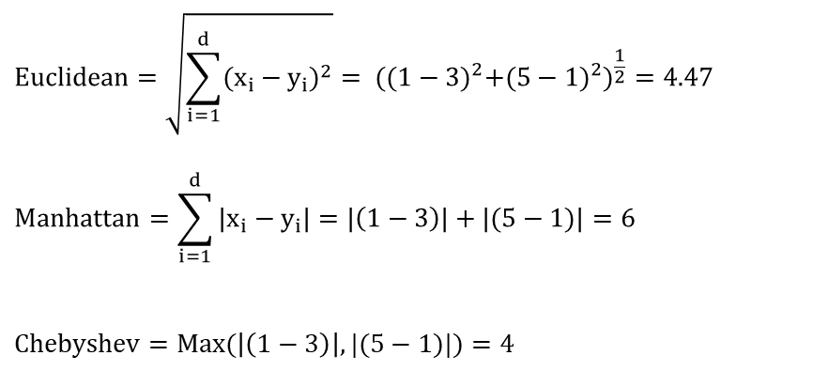
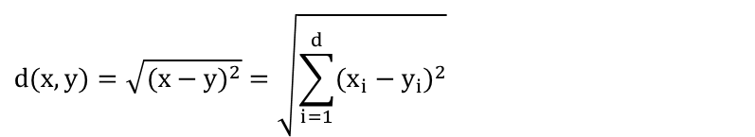
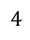
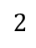
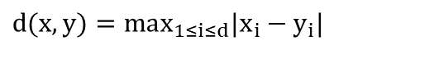
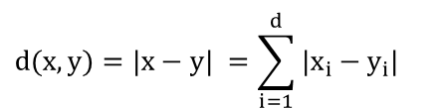
Distance Example
Euclidean Distance:
Manhattan Distance:
Chebyshev Distance:
$$d(x,y)=\sqrt{(x−y)^{2}}=\sqrt{\sum_{i=1}^{d}{(x_{i}−y_{i})^{2}}}$$
$$d(x,y)=|x−y| =\sum_{i=1}^{d}{|x_{i}−y_{i}|}$$
$$d(x,y)=max_{1≤i≤d}|x_{i}−y_{i}|$$
1 2 3 4 5
Feature 2
X (1,5)
$$Euclidean=\sqrt{\sum_{i=1}^{d}{(x_{i}−y_{i})^{2}}}= ({(1−3)}^{2}+{(5−1)}^{2})^{\frac{1}{2}}=4.47$$
$$Manhattan=\sum_{i=1}^{d}{|x_{i}−y_{i}|}=|\left(1−3\right)|+|(5−1)|=6$$
$$Chebyshev=Max(\left|\left(1−3\right)\right|,|(5−1)|)=4$$
$$4$$
Y (3,1)
$$2$$
Feature 1
1 2 3 4

Slide 9
Distance Measures for Categorical Data
Definition of distance depends on the application, type of features and clustering algorithm
There are many other distance metrics (such as Minkowski) which are used in clustering algorithms
There is no universal distance metric that is good for any clustering algorithms and for any problems.

Slide 10
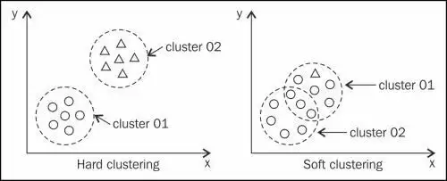
Hard vs. Soft Clustering
Hard clustering: Each datapoint belongs to exactly one cluster.
Soft clustering: A datapoint can belong to more than one cluster.

Slide 11
Main Clustering Approaches
Flat algorithms: The resulting clusters are not in a hierarchical structure
Hierarchical algorithms: The resulting clusters are in a hierarchical structure
Bottom-up (agglomerative)
Top-down (divisive)
Flat
Hierarchical

Slide 12
Partitioning Algorithms (Flat)
The data is divided into several clusters (number of clusters as a Hyper-parameter) in one shot, typically with the use of partitioning representatives, then iteratively improve results.
K-Means: the partitioning representatives (centroid) correspond to the mean of each cluster
K-Medians: the median along each dimension, instead of the mean, is used to create the partitioning representative
K-Medoids: the partitioning representative is sampled from the original data
K-Modes: The mode (most frequent category) is used as the cluster centroid

Slide 13
K-Means Clustering Algorithm
Given k as number of clusters (Hyper-parameter):
Select k random data points as initial centroid (cluster representative)
Repeat
Assign each data point to the nearest centroid
Recompute centroid of each cluster using mean values of attributes
Until convergence criteria is met

Slide 14
Sample of K-means with two cluster
Choose two random data points (No 4, No 5) as Centroids of Cluster Green (Cluster 1) and Cluster Blue (Cluster 2)
Attributes (Features)
Centroid 2
Centroid 1

Slide 15
Sample of K-means with two cluster
Calculates mean values of attributes
Repeat Calculation
With Centroids C1, C2
Unless the change in Centroid is less than 1%

Slide 16
K-means Characteristics
K-means usually stops the iterative procedure after less than 1% of the data points change their cluster memberships.
Most common measures which are used in K-means are Manhattan distance (L1 norm) and Euclidean distance (L2 norm).
Applicable only to objects in a continuous n-dimensional space
Sensitive to noisy data and outliers

Slide 17
K-Medians
K-medians defines cluster representatives as the median of the attributes (instead of mean of attributes)
K-medians is more robust to outliers than k-means
C1:
X = 1,1,2,3 Median = 1.5
Y = 1,1,2,2 Median = 1.5
C2:
X = 2,3 Median = 2.5
Y = 3,3 Median = 3

Slide 18
K-Modes
K-modes is appropriate for mixed data types (numeric and categorical)
K-Modes uses the mode (most frequent category) as the cluster centroid.
Instead of Euclidean distance it uses a distance metric for categorical attributes.
Distance (No 1, C1)= 0
Distance (No 2, C1)= 2 Distance (No 3, C1)= 1
Distance (No 4, C1)= 2
Distance (No 5, C1)= 2
Distance (No 6, C1)= 1
C1:
X = 1,1,2,3 Mode = 1
Y = 1,1,2,2 Mode = 1
Distance (No 1, C2)= 2
Distance (No 2, C2)= 0 Distance (No 3, C2)= 2
Distance (No 4, C2)= 1
Distance (No 5, C2)= 1
Distance (No 6, C2)= 2
C2:
X = 2,3 Mode = 2
Y = 3,3 Mode = 3

Slide 19
K-Medoids (PAM)
K-medoids (PAM= Partitioning around medoids) chooses the actual data points as the prototypes
Instead of taking the mean value of the object in a cluster as a reference point, another data point in the cluster can be used as representative, which is the most centrally located object in a cluster
K-medoids is more resilient to outliers and noises compared to K-means

Slide 20
Sample of K-Medoids with two cluster
Choose two random data points (No 4, No 5) as Centroids of Cluster Green (Cluster 1) and Cluster Blue (Cluster 2)
Attributes (Features)
Sum of Distances in Cluster 1 =
1.41 + 1 + 0 + 1.41 = 3.82
Sum of Distances in Cluster2 =
1 + 0 = 1
Note: Usually, Manhattan distance is used in K-medoids
But we used Euclidean distance to compare results
Total Distance = 4.82

Slide 21
Swap Centroid 1(No 5) with a random non-medoid data point:
No 1 : (1,1)
Reassign datapoints to two clusters based on distance from new centroids
New-Distance = sum of distances from (1,1) and (3,3)
If New-Distance < 4.82 :
Centroid 1= (1,1)
Best-Distance = New-Distance
Else:
Centroid 1= (2,2) [Keep the last Centroid 1]
Swap Centroid 2(No 4) with a random non-medoid data point:
No 6 : (3,1)
Reassign datapoints to two clusters based on distance from new centroids
New-Distance = sum of distances from (3,1) and Centroid 1
If New-Distance < Best-Distance :
Centroid 2= (3,1)
Best-Distance = New-Distance
Else:
Centroid 2= (3,3) [Keep the last Centroid 2]
Repeat Until Convergence

Slide 22
Weaknesses and Strengths of K-Means Family Algorithms
Strength
Fast (Usually converged after 10 – 20 iterations)
Weakness
Need to specify k, the number of clusters, in advance
Bad initial conditions may generate unimportant cells and may degrade overall performance.
Sometimes terminates at a local optimal (Initial points are important)

Slide 23
Local Optimal Problem

Slide 24
Improving K-Means Family Algorithms
The major factors that can impact the performance of the K-means algorithm are:
Selection of the initial centroids
Estimating the number of clusters (K)
Most of the variants of the k-means which differ in
Selection of the initial centroids
Dissimilarity calculations
Strategies to calculate cluster representatives (e.g., means , medians, etc.)

Slide 25
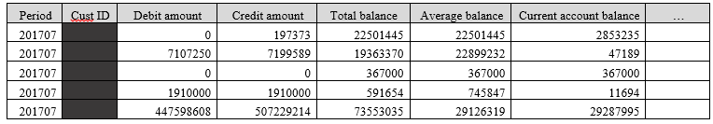
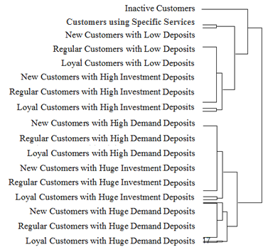
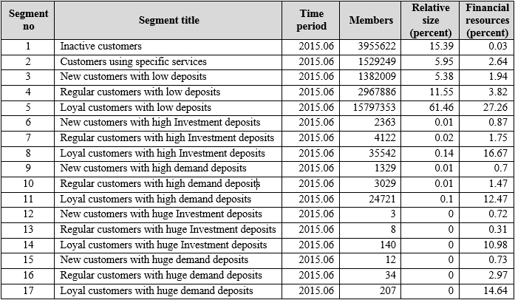
Improve Initialization of Centroids
• Perform several k-means clustering with different random initial centroids and selects the one with the least total distance
• Choose random subsamples from the data and apply K-means
clustering to all these subsamples and find centroids with the least distance
• Using the results of agglomerative hierarchical clustering
Unlabeled data
Hierarchical Clustering
K-Means

Slide 26
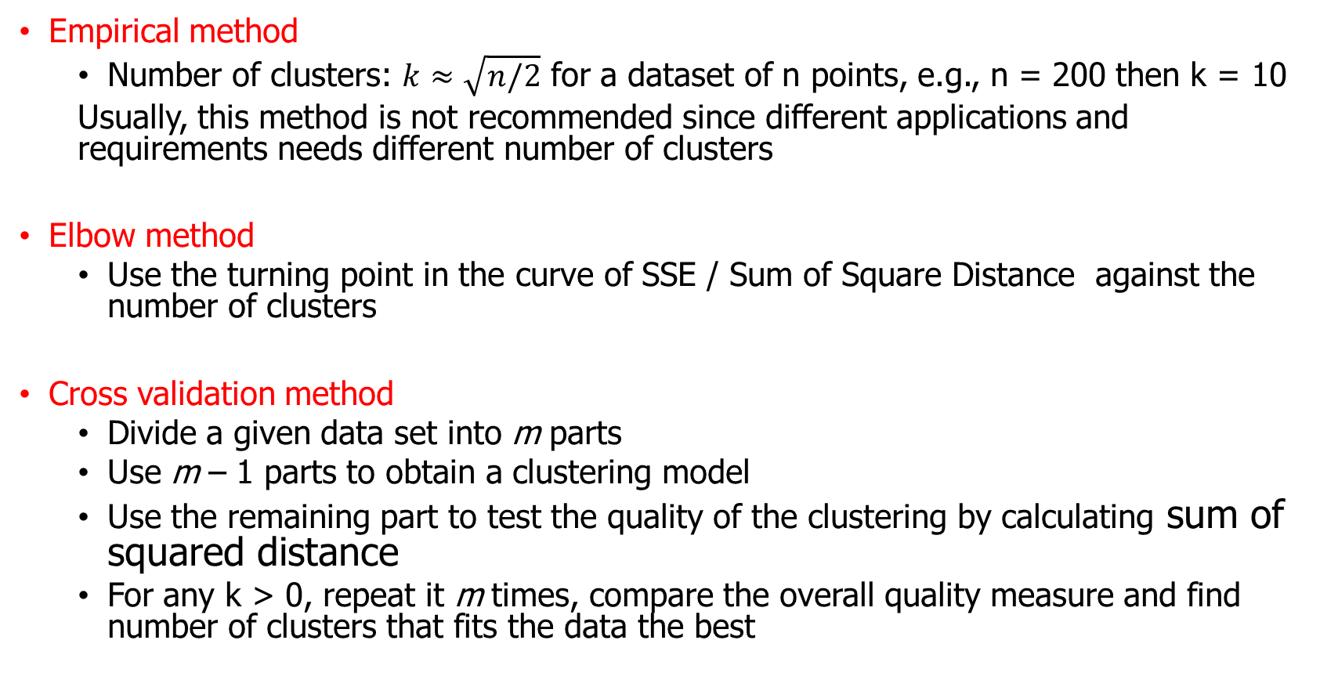
Determine the number of Clusters
Empirical method
Number of clusters: $k≈\sqrt{n/2}$ for a dataset of n points, e.g., n = 200 then k = 10
Usually, this method is not recommended since different applications and requirements needs different number of clusters
Elbow method
Use the turning point in the curve of SSE / Sum of Square Distance against the number of clusters
Cross validation method
Divide a given data set into m parts
Use m – 1 parts to obtain a clustering model
Use the remaining part to test the quality of the clustering by calculating sum of squared distance
For any k > 0, repeat it m times, compare the overall quality measure and find number of clusters that fits the data the best

Slide 27
Optimal Number of Clusters
1.00E+03
9.00E+02
8.00E+02
7.00E+02
6.00E+02
Objective Function
5.00E+02
4.00E+02
3.00E+02
2.00E+02
1.00E+02
0.00E+00
k
1
2
3
4
5
6
The abrupt change at k = 2, is highly suggestive of two clusters in the data.
This technique for determining the number of clusters is known as “knee finding” or “elbow finding”.
Resulting clusters of a well-tuned clustering method should be meaningful in the context of business

Slide 28
Problems with Distance-based Algorithms
Distance-base function are not efficient in clustering data structures with different cluster radius
Distance-base function are not efficient in clustering data structures with non-convex shape

Slide 29
Density-based Methods
• Density-based and grid-based methods try to explore the data space at high levels of granularity.
• The density at any particular point in the data space is defined either in terms of the number of data points in a pre-specified volume of its locality or in terms of a smoother kernel density estimate
• Grid-based methods are a specific class of density-based methods in which the individual regions of the data space which are explored are formed into a grid-like structure.
• Grid-like structures are often particularly convenient because of greater ease in putting together the different dense blocks in the postprocessing phase.
• Such grid-like methods can also be used in the context of high-dimensional methods, since the lower dimensional grids define clusters on subsets of dimension

Slide 30
Hierarchical Clustering
Hierarchical clustering is a nested sequence of partitions
Agglomerative (Bottom Up):
Places each object in its own cluster and gradually merge the atomic clusters into larger and larger clusters.
Divisive (Top-down):
Start with all objects in one cluster and subdivide
into smaller clusters.

Slide 31
Agglomerative Methods
- Start with a partition P of the data in which each sample is in its own
singleton cluster.
- At each stage, two clusters are chosen from P and merged, forming
a new partition P’.
- The pair which is merged is the one which gives the highest resulting
likelihood (less intra-cluster distance).
- The process is greedy. The best choice at a certain stage (local optimal) does not
necessarily develop into the best global result.

Slide 32
Distance between Clusters
Single linkage (nearest neighbor): In this method the distance between two clusters is determined by the distance of the two closest objects (nearest neighbors) in the different clusters.
Complete linkage (furthest neighbor): In this method, the distances between clusters are determined by the greatest distance between any two objects in the different clusters (furthest neighbors).
Average linkage: In this method, the distance between two clusters is calculated as the average distance between all pairs of objects in the two different clusters.
Other distances e.g., Ward linkage

Slide 33
Agglomerative Example
Merge 3, 4

Slide 34
Merge 1, 2
Merge 1, 2
Merge 1, 2

Slide 35
Merge 1, 2
Merge 2, 3
Merge 1, 2

Slide 36
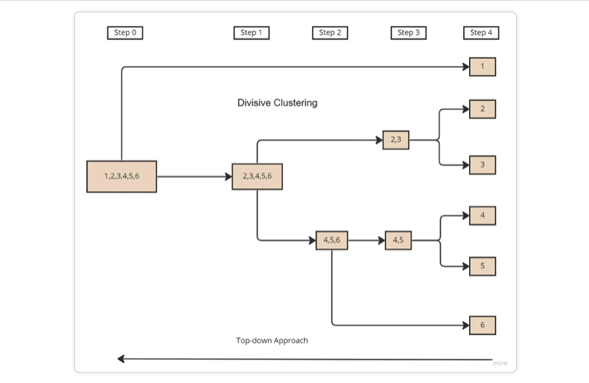
Divisive Hierarchical Clustering
Step 1: Consider all objects in one cluster.
Repeat
Step 2: Spilt the cluster into K (Hyper-parameter) clusters using any flat-clustering method (e.g., k-means).
Step 3: Selects a cluster with the biggest sum of inter-cluster distances based on some distance metric such as Euclidean distance.
Until each data point forms its own cluster.

Slide 37
Cut Hierarchical Tree
Elbow Method
Use the turning point in the curve of SSE / Sum of Square Distance against the number of clusters
Cluster Validity Approach
Test different levels (cuts) of three with Cluster Validity metrics to find out which one produces the best results

Slide 38
Cluster Validity
Minimize within cluster distance
Maximize between cluster distance
separation
cohesion

Slide 39
Measuring Clustering Quality (validity)
External: supervised, employ criteria not inherent to the dataset
Compare a clustering against prior or expert-specified knowledge (i.e., the ground truth or labels) using certain clustering quality measure
Internal: unsupervised, criteria derived from data itself
Evaluate the goodness of a clustering by considering how well the clusters are separated, and how compact the clusters are, e.g., Sum of Squared Error (SSE) , Entropy, Silhouette coefficient, Dunn's index
Relative: directly compare different clustering, usually those obtained via different parameter settings for the same algorithm. Often an external or internal index is used for this function, e.g., SSE or entropy

Slide 40
Measuring Clustering Quality: External Methods
Quality is good if it satisfies the following five essential criteria
Cluster homogeneity: the purer, the better
Cluster completeness: should assign objects belong to the same category in the real-world to the same cluster
Rag bag: putting a heterogeneous object into a pure cluster should be penalized more than putting it into a rag bag (i.e., “other” category)
Small cluster preservation: splitting a small category into pieces is more harmful than splitting a large category into pieces
Meaningfulness : Clusters should be meaningful in the context of business

Slide 41
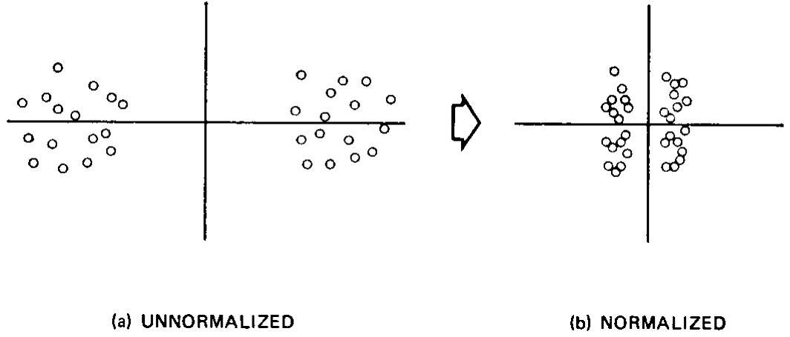
Data Pre-processing for Clustering
Missing Values are required to be imputed before clustering since distance metrics are employed.
Normalizing data is recommended since attributes with larger range of values can bias some distance measures.
Filter out outliers is recommended for many clustering algorithm such as K-means which are prone to outliers

Slide 42
Hierarchal Clustering Methods
No need to specify the number of clusters in advance
Hierarchal nature provides more transparency and interpretability of results for subject matter experts
Gives meaningful insights into structure of data
Like any greedy algorithm, local optimal is a problem
Interpretation of results is subjective
Computationally expensive when dealing with large datasets

Slide 43
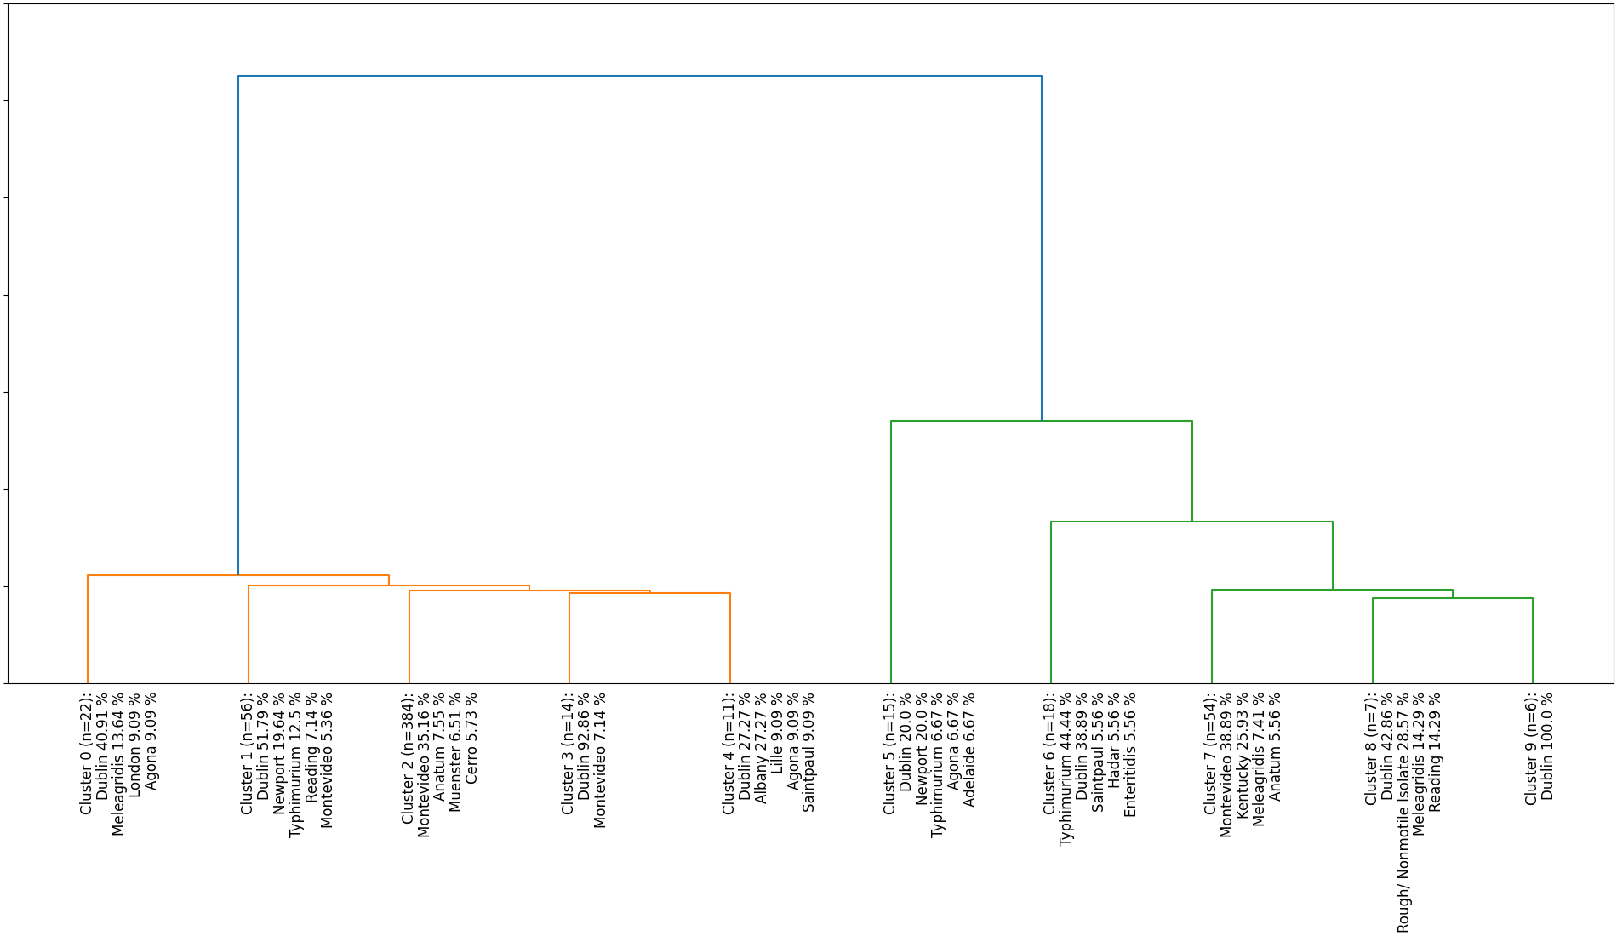
Applications of Hierarchal Clustering

Slide 44
Hierarchical Clustering Various Visualizations

Slide 45
Assignment 3
Use data preprocessing methods suitable for clustering on market_ds.csv (Files section) containing marketing data.
Find an optimal number of clusters for k-means over the marketing data.
Use the optimal cluster number in K-means to cluster the marketing data.
Visualize the relations between income and spending for all resulting clusters using a scatter plot.
Visualize the relations between income and age for all resulting clusters using another scatter plot.
Try to find names for different clusters based on scatter plots.

